Slide 1

RISKCOG
Implicit and Continuous
User Identification on
Smartphones in the Wild
Jiham Lee jihamlee2017@u.northwestern.edu
Karan K Shah karan.shah@u.northwestern.edu
Sandeep Raju Prabhakar srp@u.northwestern.edu
EECS 450 : Internet Security
Fall 2016, Northwestern University
Notes:
Dddmbd

Slide 2
Data Collection from Smart Watch

Slide 3
Outline
Introduction
Android Data Collection
Iphone Data Collection
Flaws
Future Work

Slide 4
Introduction
Collection of data from smart watch as it being used by most people
It is used for extraction of features from the data collection
Similar to the current technique used by RiskCog only instead data collected from the watch

Slide 5
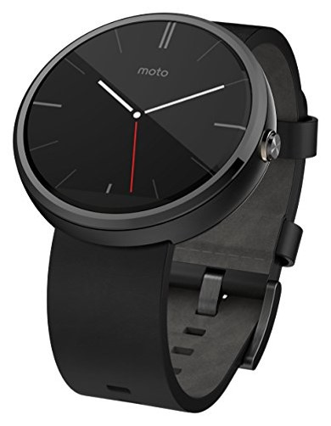
Android Data Collection
Application for the phone : Sensor Dashboard
Smart Watch : Moto 360
Sensors Used : Accelerometer and Gyroscope

Slide 6
Sensor Dashboard
Application used for gathering data from the sensors in the watch
For each axis in sensor different color is used to distinguish them
Blue – Axis 1
Purple – Axis 2
Green – Axis 3

Slide 7
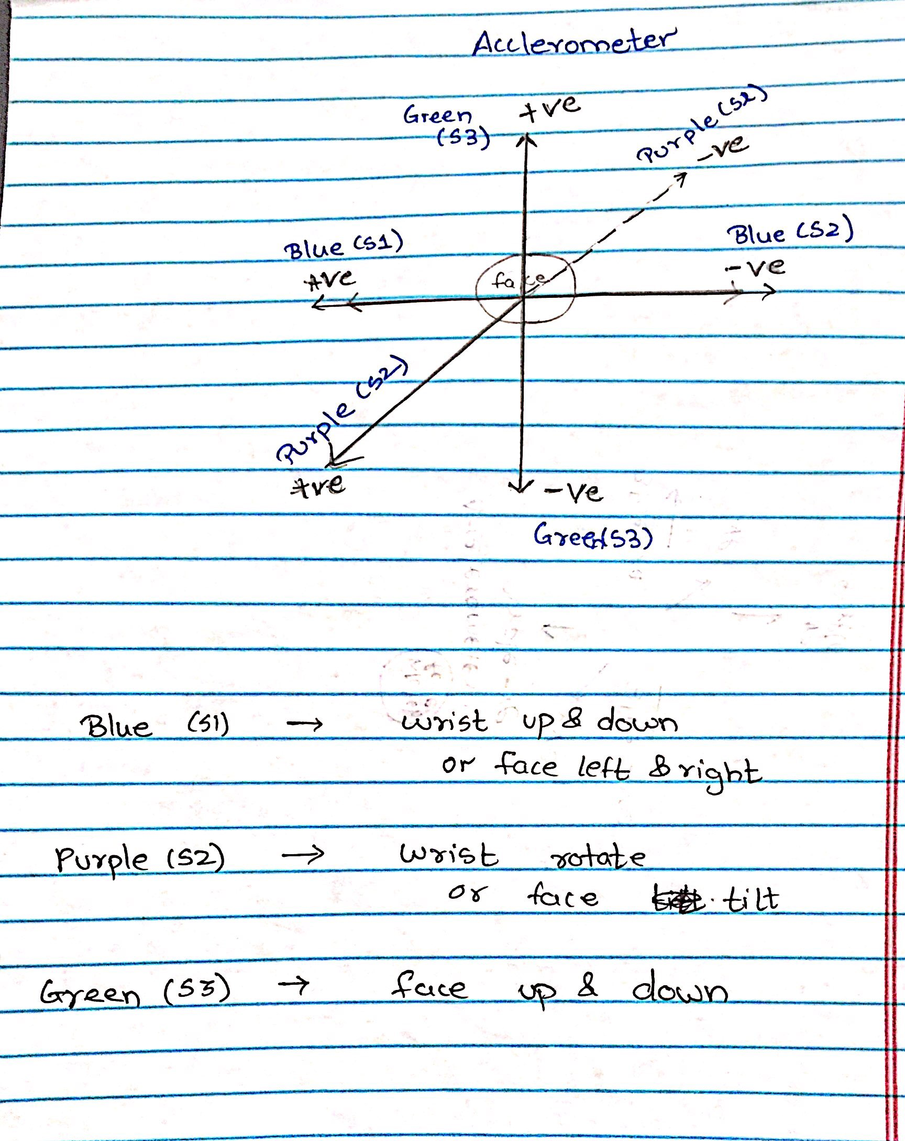
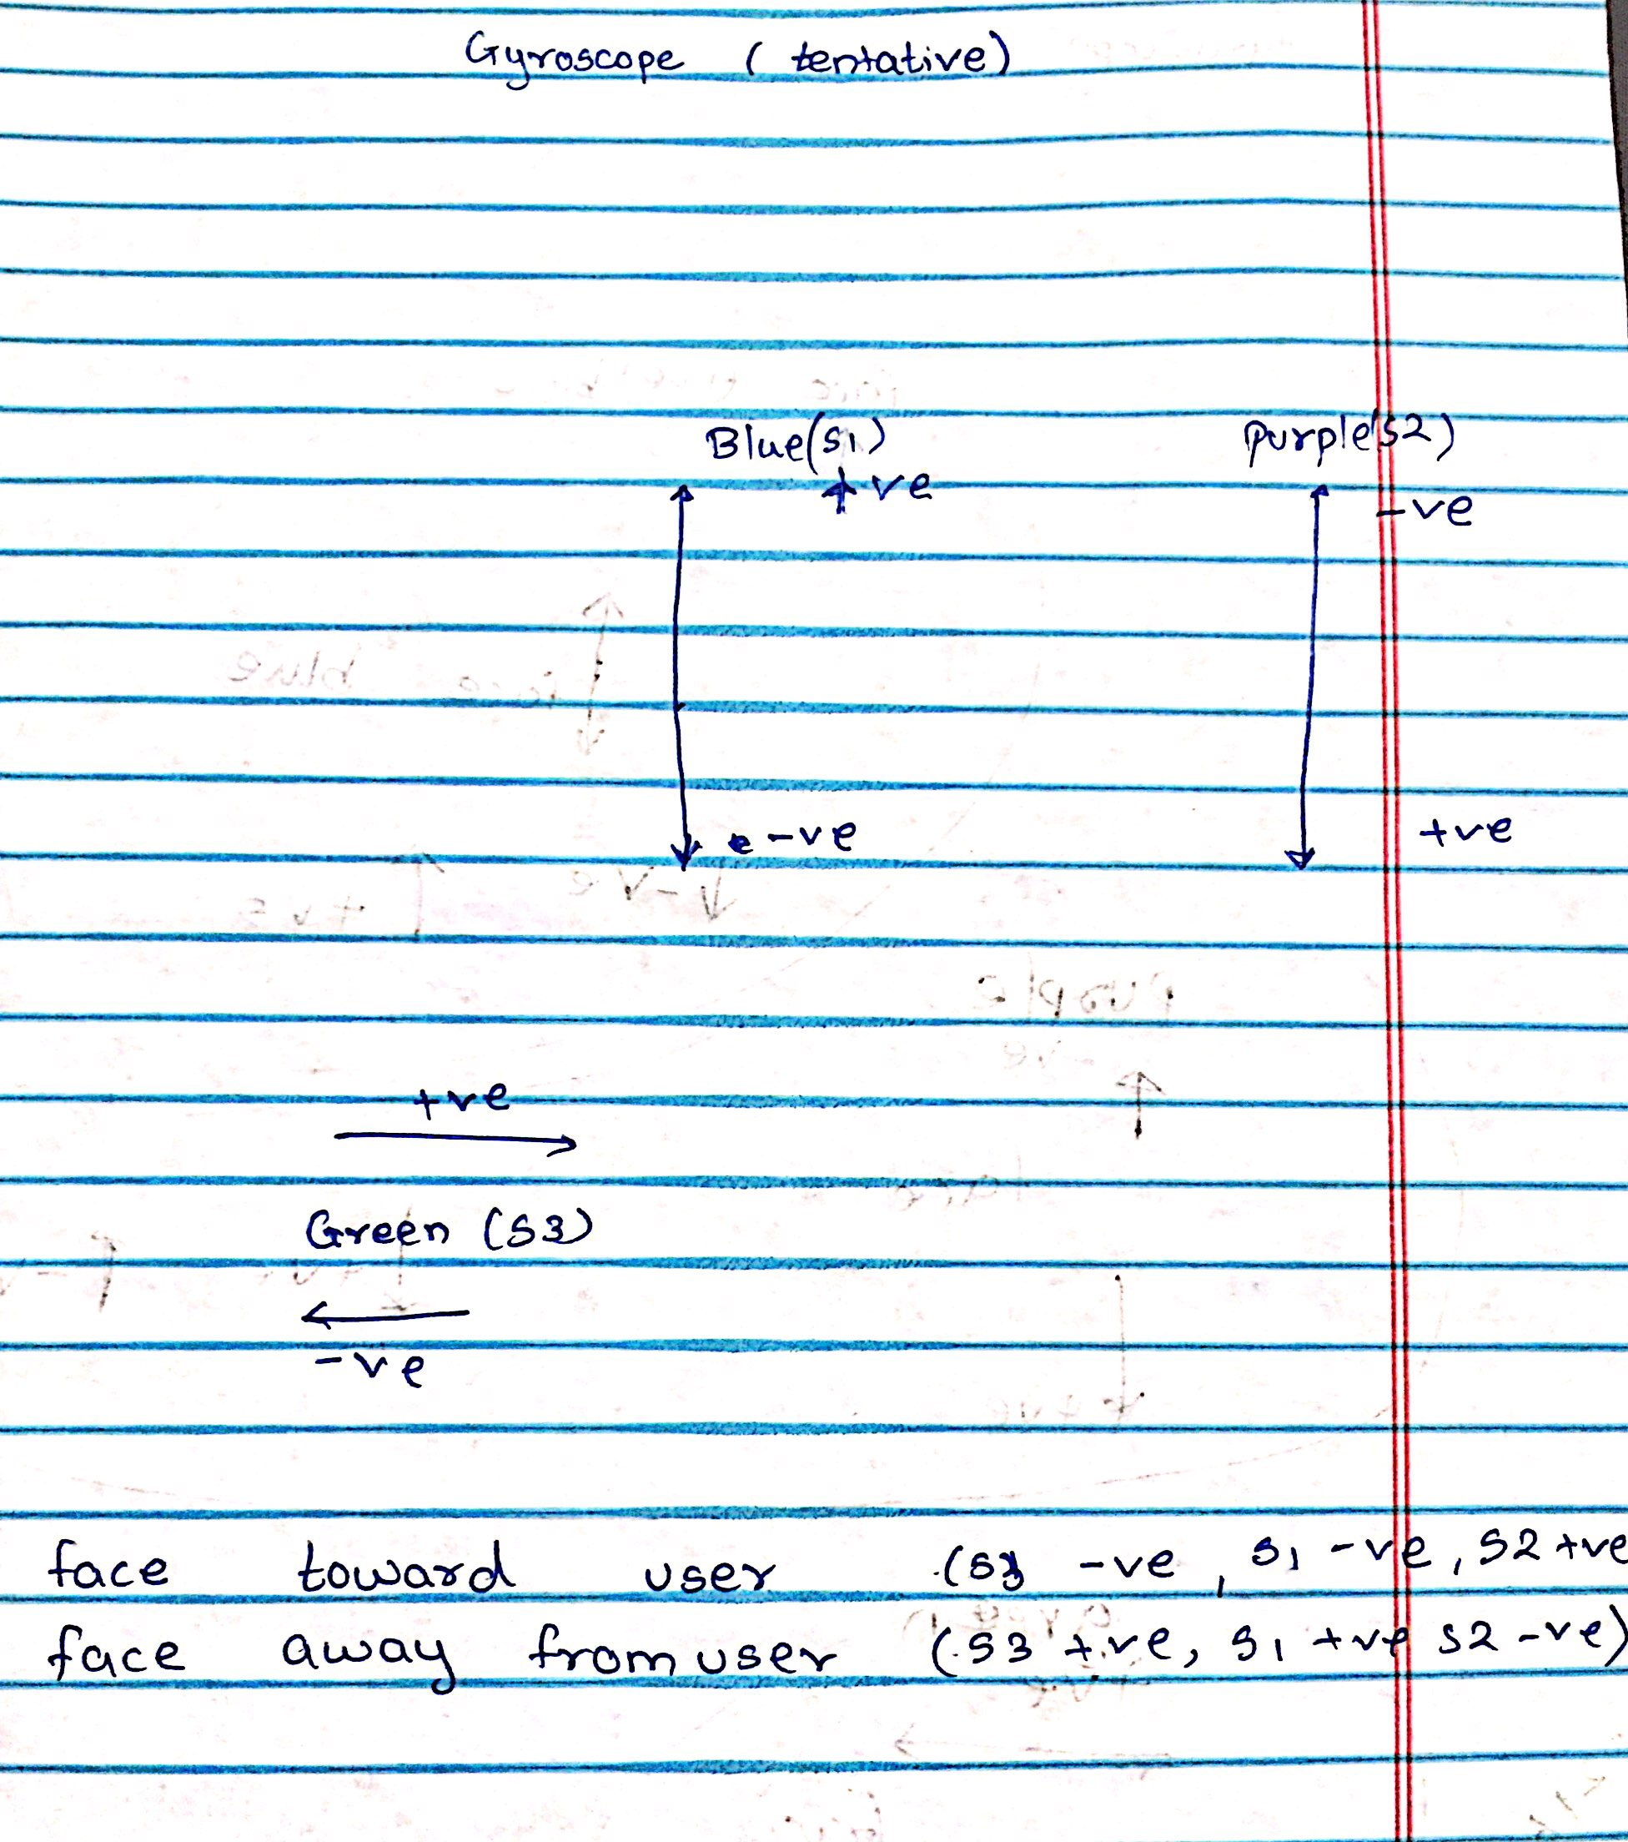
Accelerometer and Gyroscope Axis Configuration

Slide 8
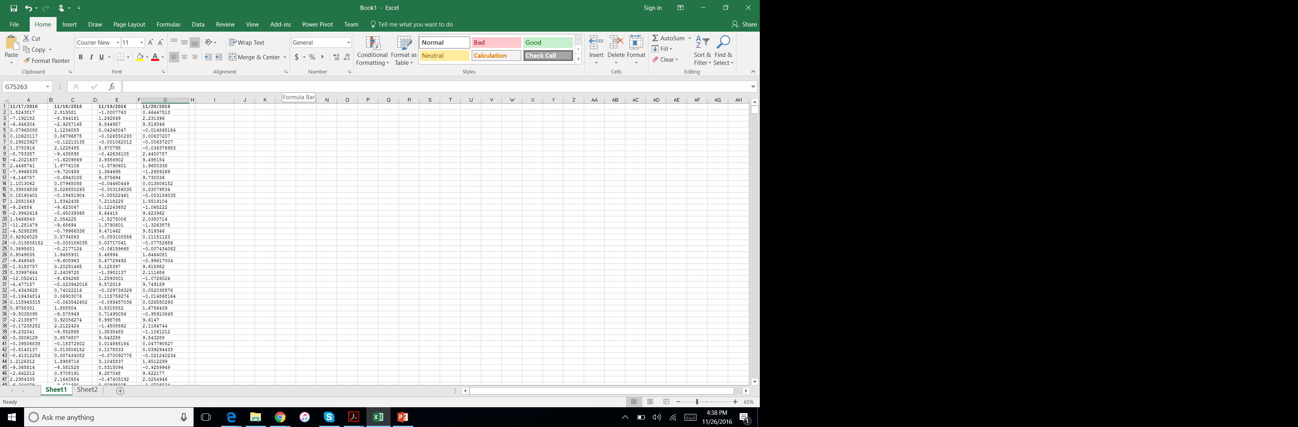



Values and Graphs

Slide 9
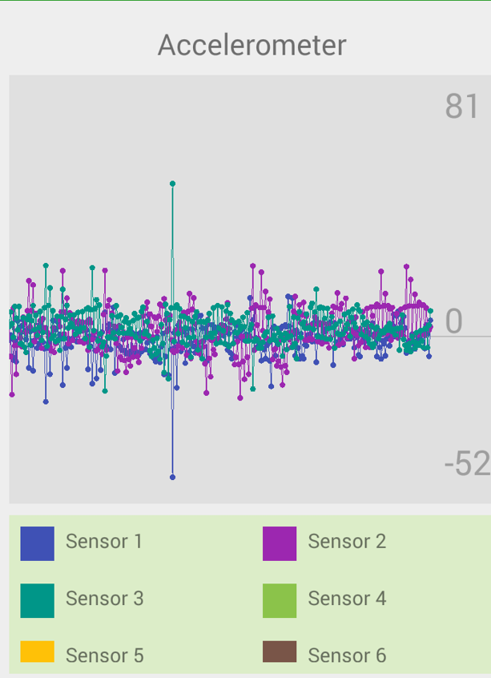
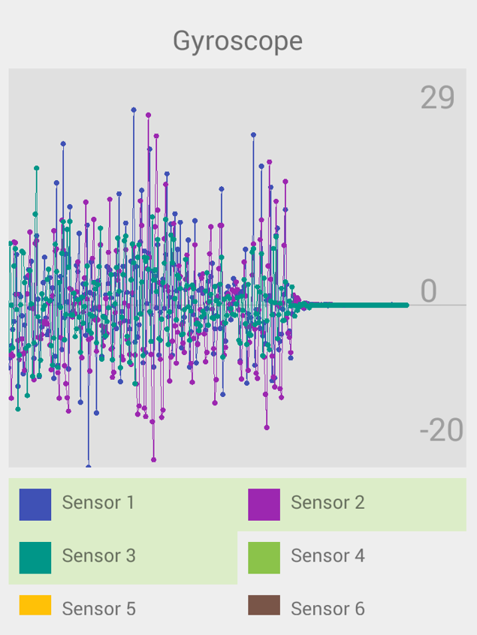

Slide 10
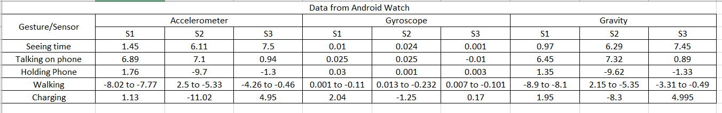
Data for Particular Features

Slide 11
Iphone Data Collection
Application for the phone : PowerSense , Gathered Data
Smart Watch : iWatch 2.0
Sensors Used : No

Slide 12
PowerSense
Developed by Shiyan Xu
It shows the sensor data live value when collection from mobile phone

Slide 13
Gathered 1.2
Developed by Yetii Ltd.
It does not have any graphs that shows the sensor values.
Measures only the accelerometer using the watch

Slide 14
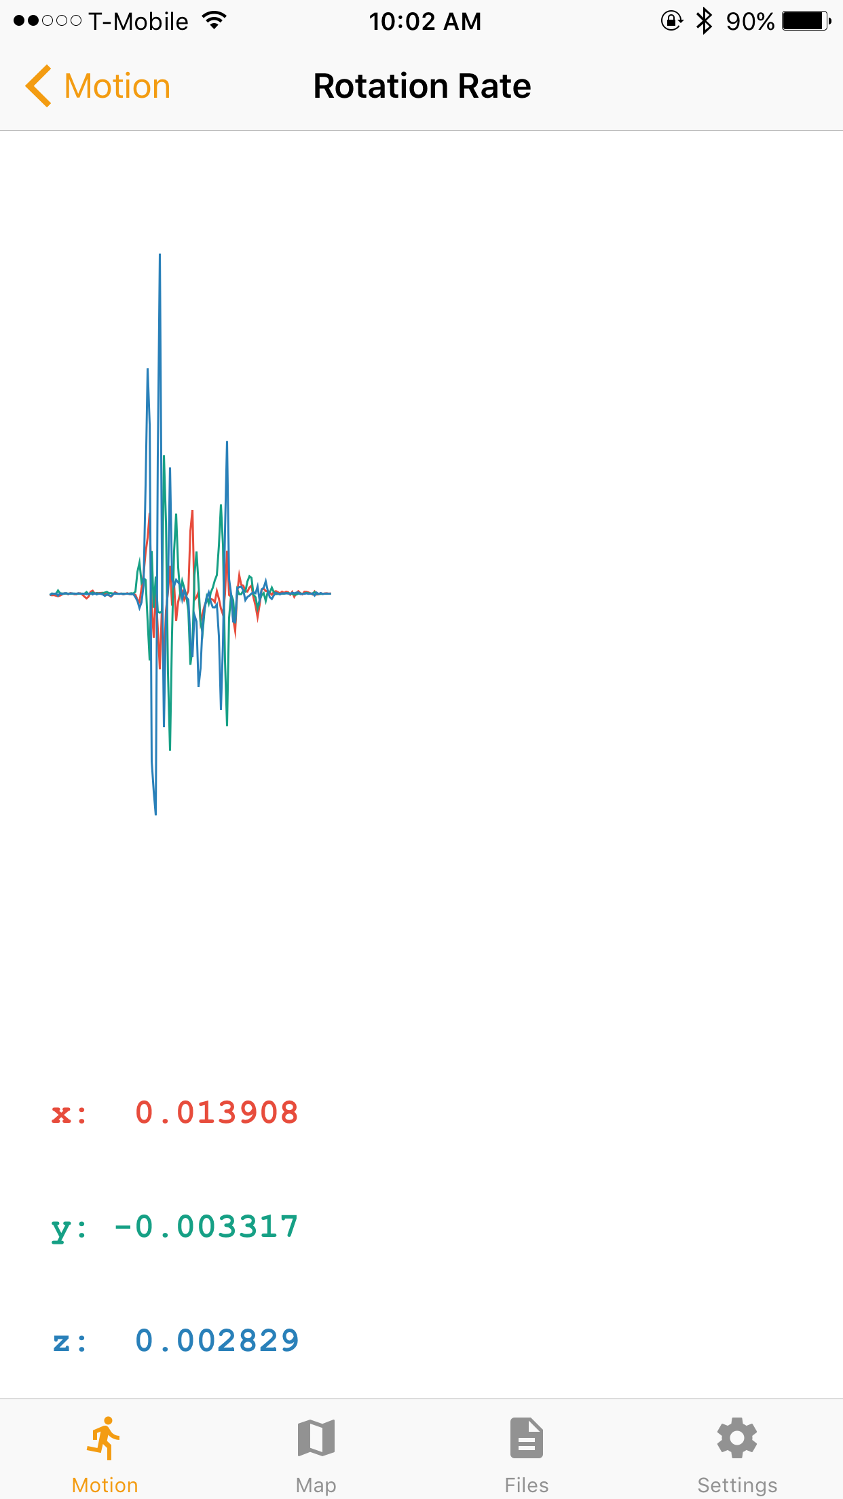
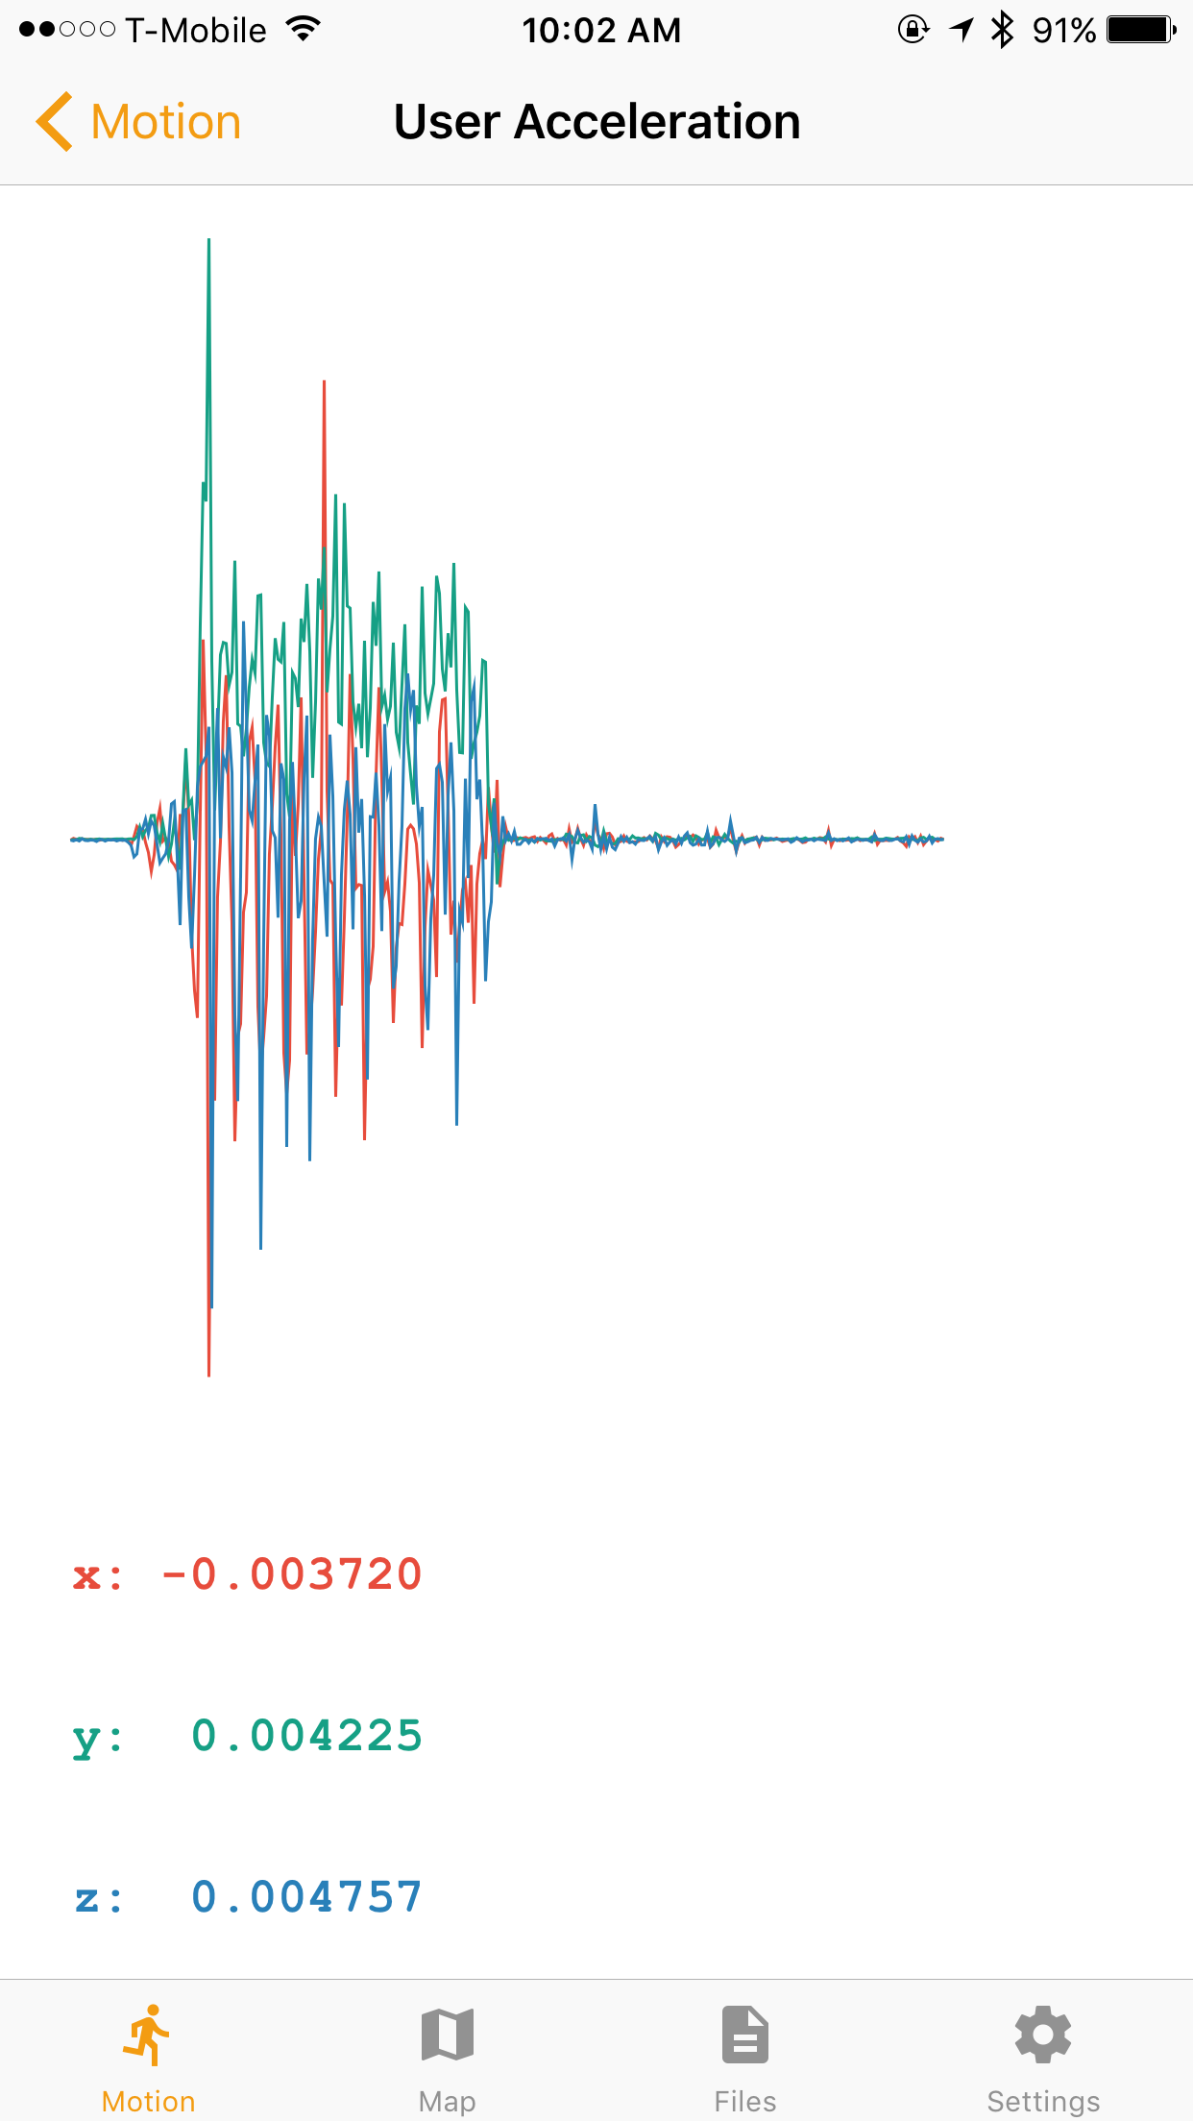
Accelerometer and Gyroscope Axis Configuration
Gyroscope
Accelerometer

Slide 15
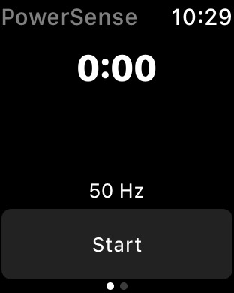
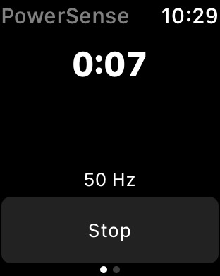
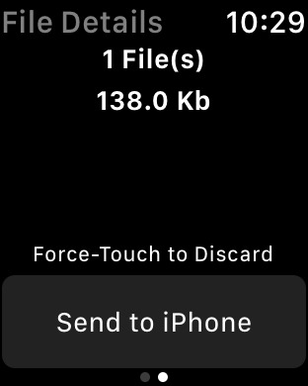
iWatch

Slide 16
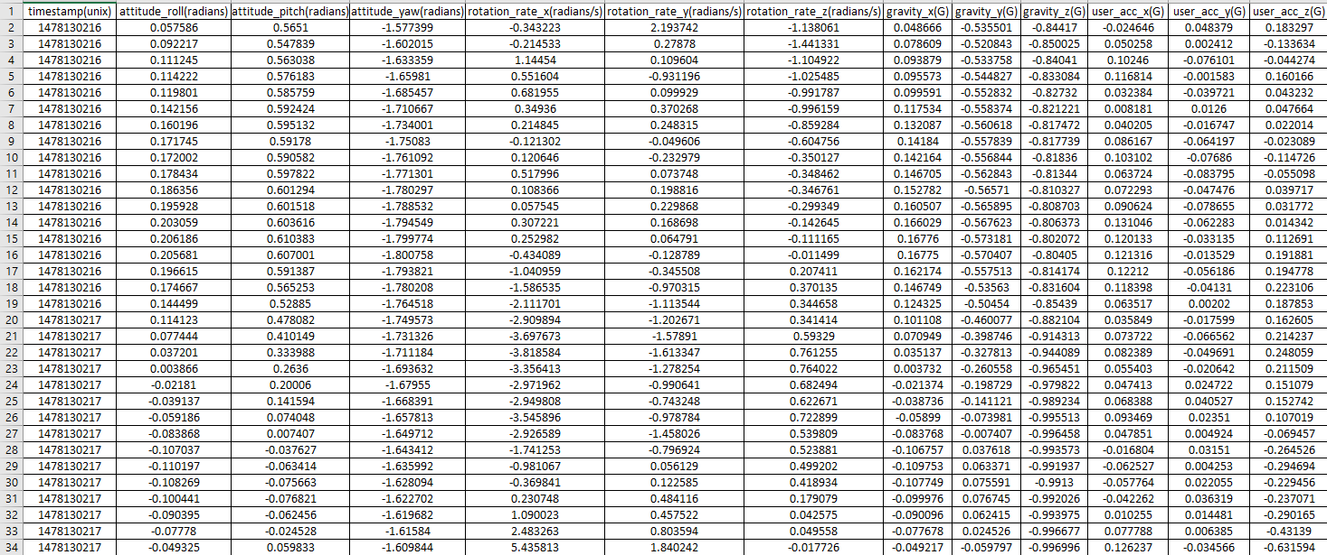
Values

Slide 17
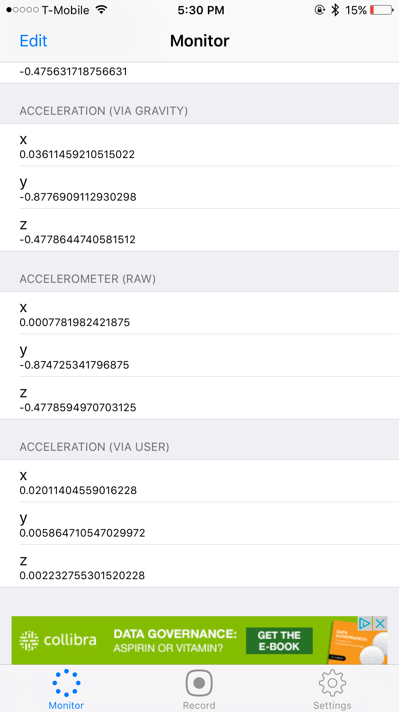
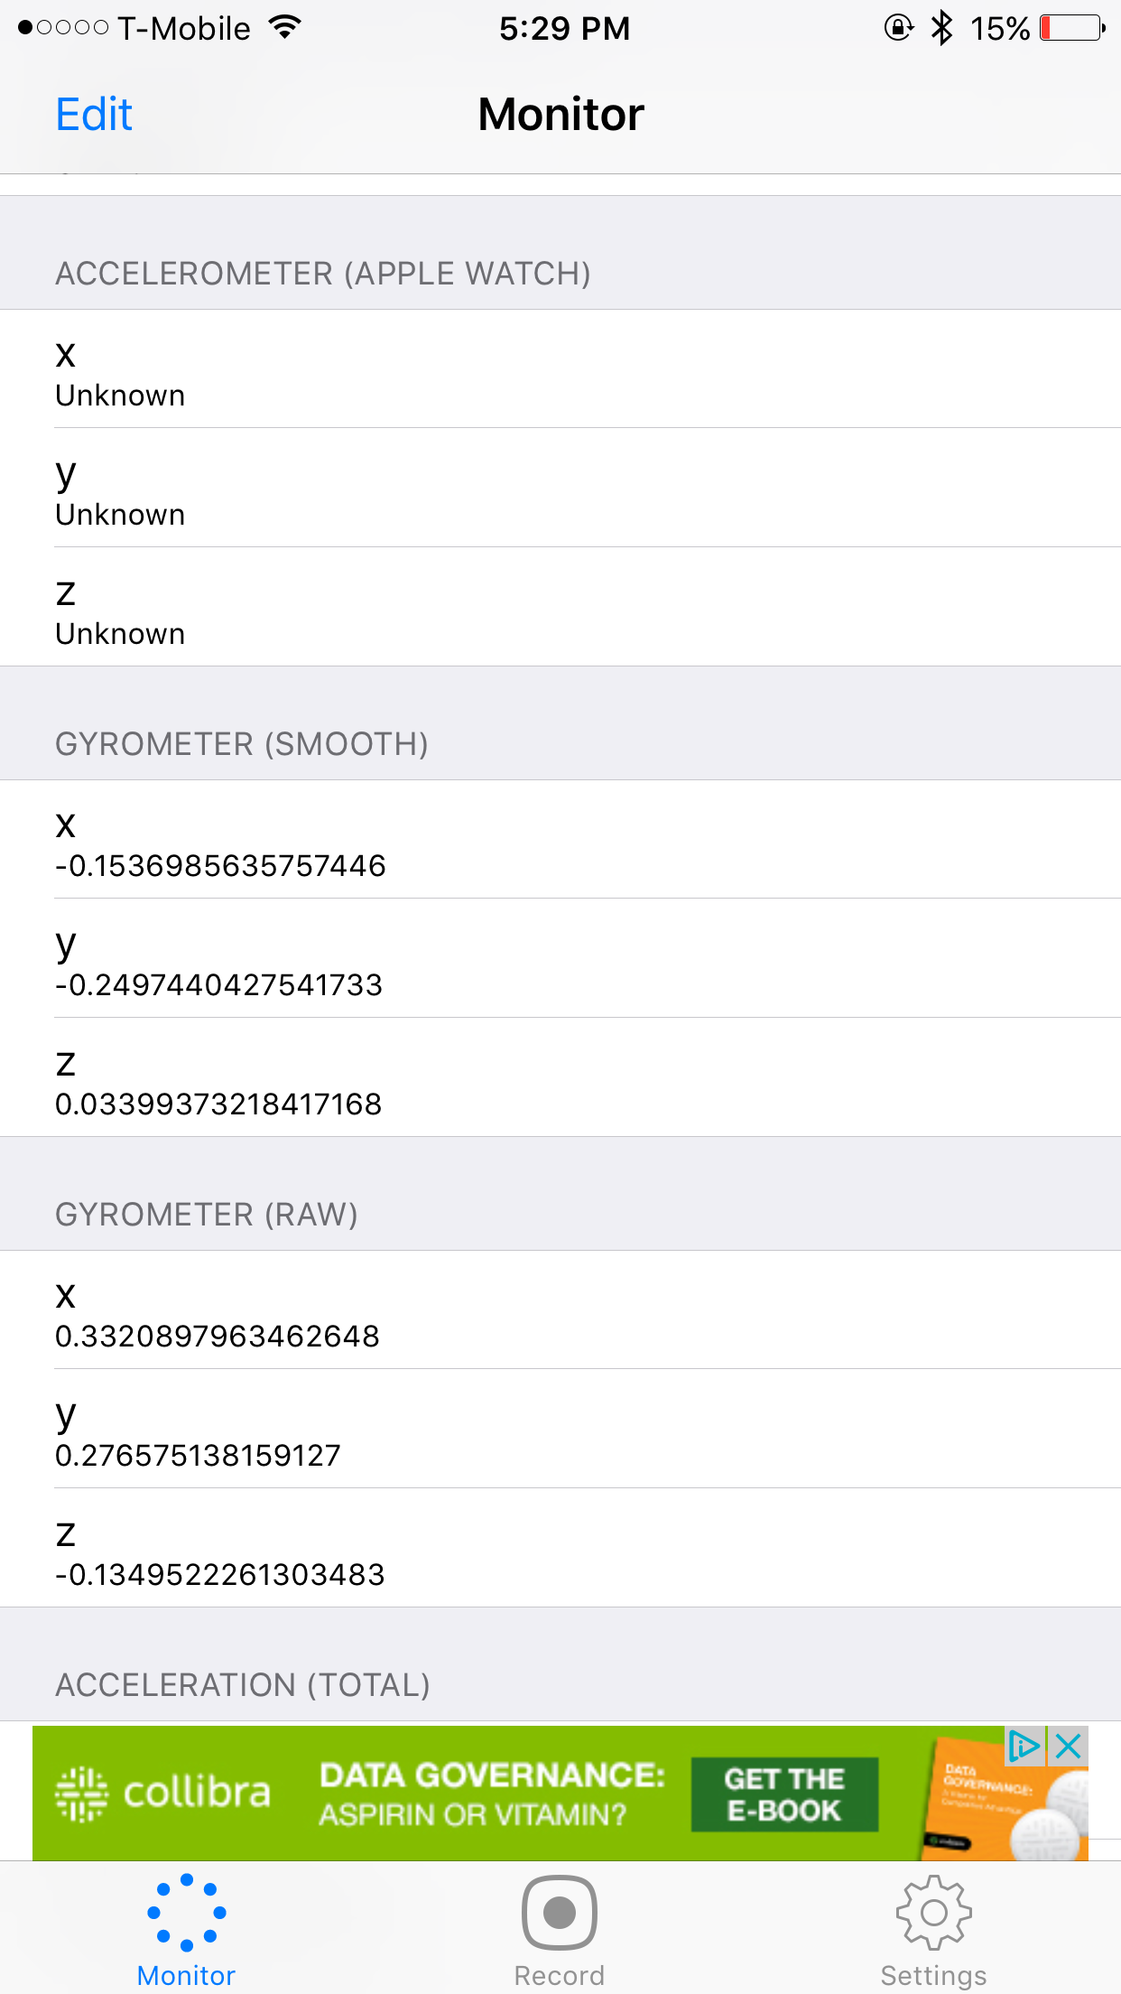
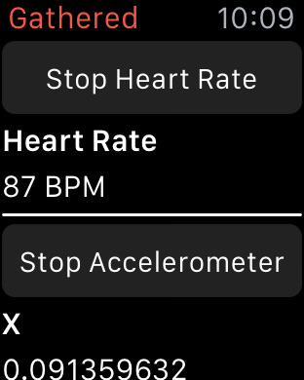
Values from Gathered - Monitor and Record Device Sensors

Slide 18
Flaws
It does not have an inbuilt sensor. It uses the linear acceleration of the watch
Bulk of data
Some of the data is not used and you cannot send more than 1 Mb of data

Slide 19
Future Work
Designing the application in Xcode for making it compatible with iPhone
Sending the data to the server so training of the data can take place and configuring the application for that

